Slide 1
Policías y Ladrones

Slide 2
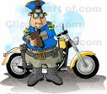
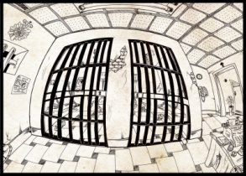
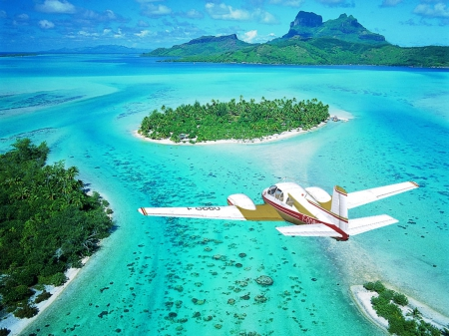
Señor Morales
Señorita Huber
Señor Morales y Señorita Huber han robado el banco!!!
Se han escapado con 5 millones de euros pero la policía les está persiguiendo.
¿Quién acabará en la cárcel?
y...
¿Quién llegará a la isla desierta con los
5 millones de euros?

Slide 3
Game Rules and explanation
There is a red team and blue team (teacher will divide students), the first team to the airplane wins. Each student gets a white board and a dry erase marker.
There are 18 Categories (teacher can change these to suit needs of class)
Examples: Family Members, Animals, Colors, Activities, Verbs, Months, School Vocabulary, Fruits, Vegetables, Spanish speaking countries, etc.
A coin is flipped to see which team goes first
The first team to go will answer their corresponding color question for the first square. Students may only write 1 response per white board and any repeats or similar answers will only be counted as 1 point. The teacher will set a timer for 30 seconds and the students will write down as many answers as they can. After the 30 seconds, the teacher will count correct responses and how many squares the team gets to move. Students from the same team are allowed to work together if they need help generating ideas or with spelling or grammar (teacher will use discretion for spelling/accent errors)
0-5 correct=1 square
5-10 correct=2 squares
10+ correct= 3 squares
The green squares are team work squares, students can collaborate to find responses and help correct each other with spelling and grammar. They can also work as a team to ensure that there are no double responses for the group.
The yellow squares are individual work squares, students must come up with an answer individually. Teacher can decide based on the time of year and knowledge of the subject if marks will be deducted for spelling/grammatical errors, or add bonus points as a reward for correct spelling and grammar.

Slide 4
Game Rules and Explanation Continued
The Purple squares are oral squares and each student will get a chance to say an answer verbally and the teacher will write these down on the smart board for the students. There is extra time allowed for the purple squares and can be decided ahead of time(10-20 seconds per team member). No double answers will be counted. *Teacher can choose which student to call on first, second, third, etc. to create more ease or difficulty depending on the students (stronger students who need a challenge should go last after more responses have been given).
5. The opposite team will repeat play
6. The categories will be randomly divided between the squares so students don’t know what their questions will be until they land on that particular square.
7. If you land on a star square, you get a bonus 15 seconds for the round (45 seconds)
8. If you land on a “No symbol” square you get 15 seconds less for the round (15 seconds only)
9. If you land on the lightening bolt square the points for that round are secret (teacher can vary this each time)
E.g. 0-5 correct =2 squares, 5-10 correct= miss a turn, 10+correct =1 square.

Slide 5
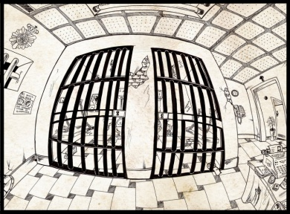
Policías y Ladrones
18
17
La Cárcel
16
La Isla
11
12
13
14
15
10
9
8
7
6
1
2
3
4
5

